Slide 1
REMster: Final Overview
Project and Presentation by:
Harrison Moore
Taylor Neller
Notes:
Welcome to the launch demonstration of our new web application, REMster! My name is Harrison Moore, and I’m joined by Taylor Neller. Together, we comprise the REMster development team. Today, we're going to give you a quick demo of our new music streaming service that we've been working on for the past few months. Let’s get started!

Slide 2


The Past is The Future
+
=
REMster
Abundant content,
freely available
Social features,
pleasant interface
The best of both worlds
Notes:
REMster is a free music streaming service that allows you to stream any song uploaded by an Administrator for free. It combines the ease and convenience of Napster with the sleek UI of Spotify, making it the perfect platform for music lovers everywhere. We placed a lot of emphasis on ease of use, understandability, and replicating the Spotify UI as closely as possible. The result is a simple, intuitive, and error-safe experience for the end user. Throughout this presentation, we'll be showcasing some of the key features of REMster, including its current feature set, some of the development aspects that took more work than others, and plans for future expansion. Let's dive in and explore what makes REMster so unique and exciting.

Slide 3
Completed Functionalities
General:
Personalized homepage
Search for songs, artists, albums, or playlists with intelligent results
Create, edit, and delete playlists
“Like” and “unlike” songs from any instance of that song
Intelligent song metadata for additional detail
Slick, easy, and understandable user interface
Complete account control: register, change password, enable / disable admin privileges
Complete playback control: shuffle, repeat, skip forward, skip backward, volume slider
Admin:
Upload and remove albums
Add artists
Curate playlists to be recommended for end-users
Notes:
When developing REMster, we prioritized features that are expected of any music playback application, such as arrangement of songs into albums or playlists and movement between songs with controls like shuffle and repeat. Once this core functionality was in place and polished to look as professional as possible, we encased it with convenient navigation. When logging in, a user is brought to a homepage featuring a random selection of albums from the REMster catalog and an assortment of playlists curated by REMster admins. If a user can’t find what they’d like there, the Search bar will have them covered. We’ve allowed for much wiggle-room

Slide 4
Incomplete Functionalities
“Recently Listened” on homepage instead of pulling randomly
More generalized error-handling (central 404 page)
Unhandled errors only appear if tampering with URLs
Notes:
A few other functionalities we did not have time to implement were the recently listened part of the homepage and more advanced error handling. Originally, we planned to track when the user listened to various songs and then show them the songs they listened to previously, but we did not have time to add this. Additionally, there can currently be a few errors regarding the php redirects, for instance if someone manually types something into the URL or get a 404 error.

Slide 5
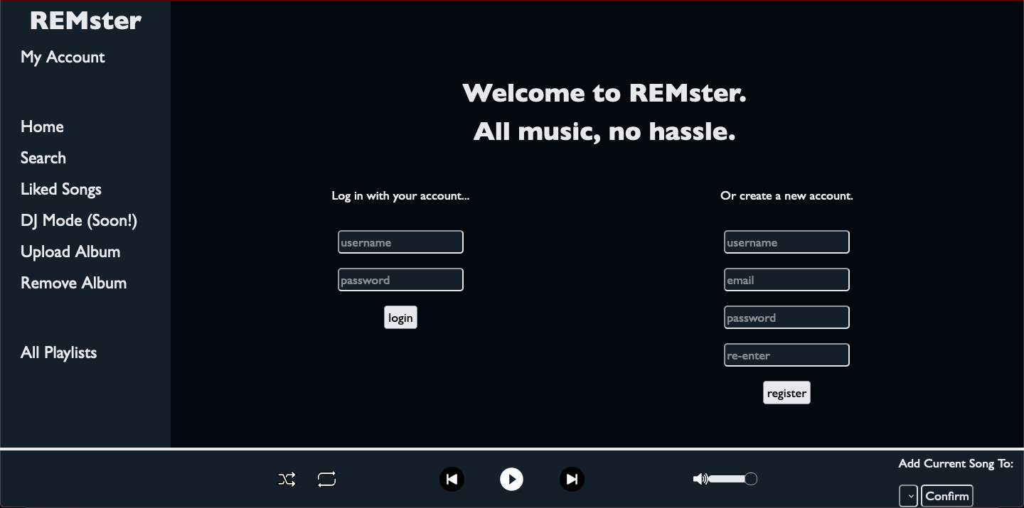
Landing Page
Notes:
On the landing page, the user is prompted to log in, or to create a new account if they do not have one. The password are encrypted, and there are two types of users: basic and admin. Basic users can browse as they please, and admins can upload albums, remove albums they have uploaded, and create artist profiles. At any time, a user may switch between a user and admin account from the “My Account” screen, which is discussed later in the presentation.

Slide 6
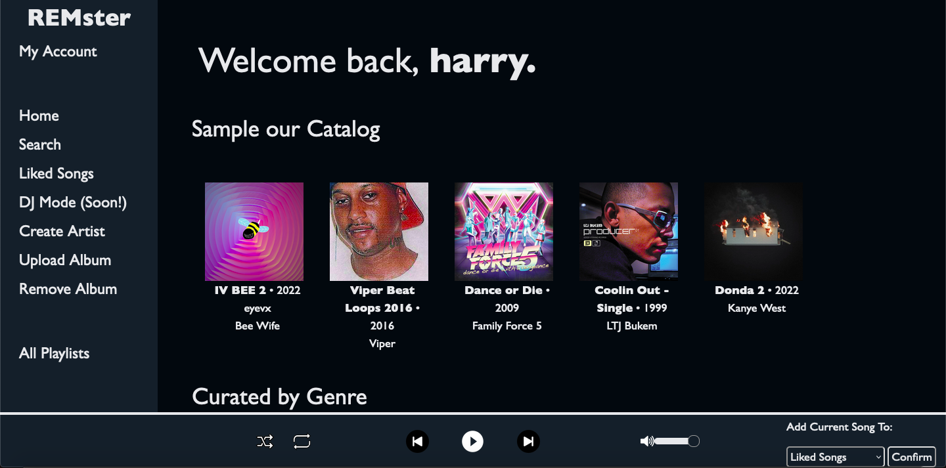
Home Page
Notes:
On the home page, one can see a variety of albums that they can navigate to. Clicking any album tile takes a user to that album; the same is true for playlist tiles. Were the database of songs populated with more albums, the albums shown here would be pulled randomly.

Slide 7
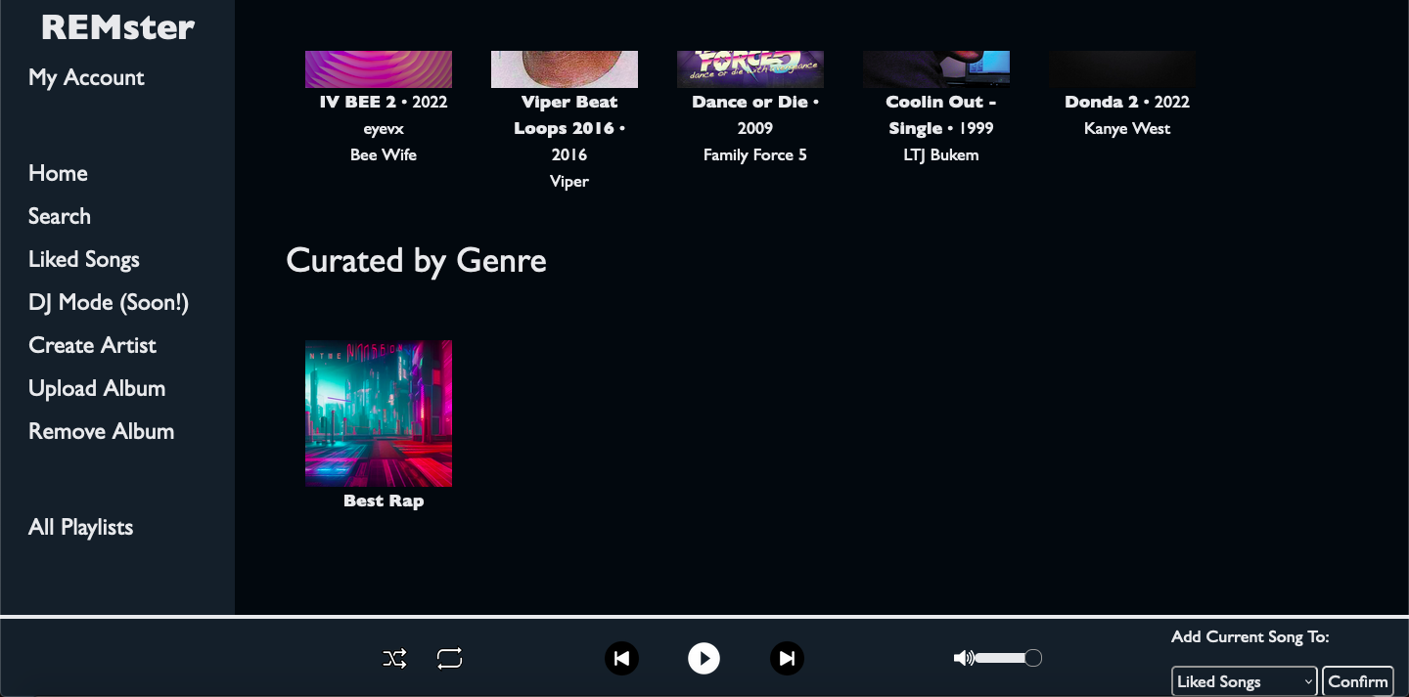
Home Page - Scrolled Down
Notes:
Also on the home page are different playlists curated by genre that can be added to the dashboard by admins. This process is as simple as creating a playlist and checking “add to curated”.

Slide 8
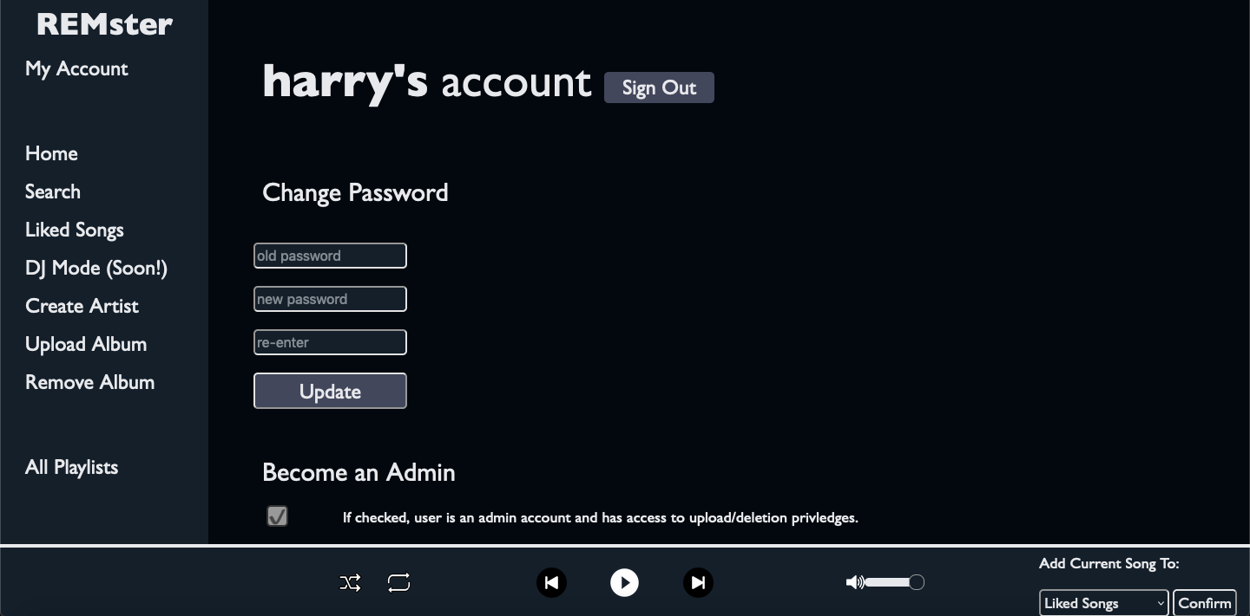
Account Page
Notes:
After logging in, a user can navigate to the “My Account” page on the sidebar to change their password, promote their account to admin, or sign out. In a real-world production scenario, one would need to verify admins to prevent abuse, but for our case we use this solution of promotion in the account page as a demonstration. To accommodate for the accessibility that Napster was so famous for, the verification would be accessible to all who could pass it.

Slide 9
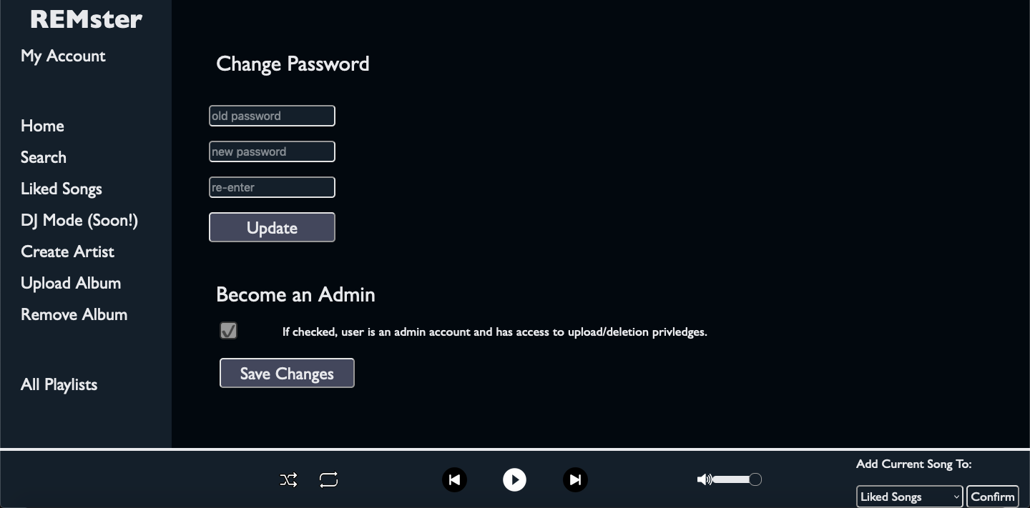
Account Page - Scrolled Down
Notes:
After logging in, a user can navigate to the “My Account” page on the sidebar to change their password, promote their account to admin, or sign out. In a real-world production scenario, one would need to verify admins to prevent abuse, but for our case we use this solution of promotion in the account page as a demonstration. To accommodate for the accessibility that Napster was so famous for, the verification would be accessible to all who could pass it.

Slide 10
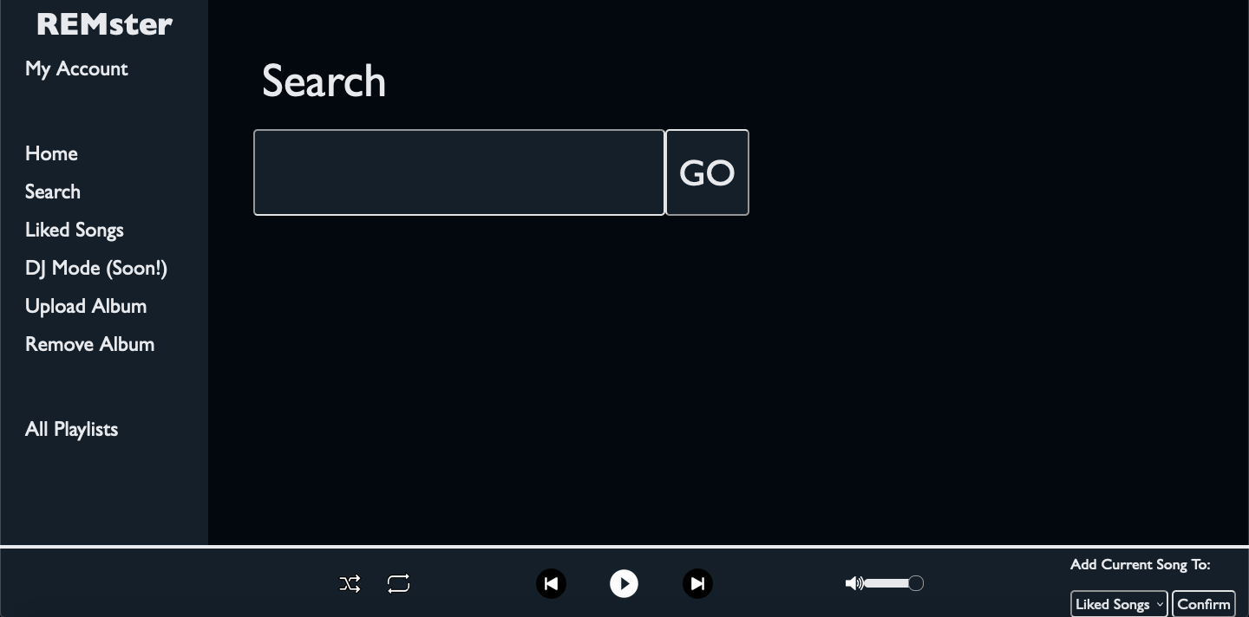
Search Page
Notes:
There is a search functionality, such that one can type the name of a song or album, and then find similar search results. It will search through songs, albums, playlists, and artists.

Slide 11
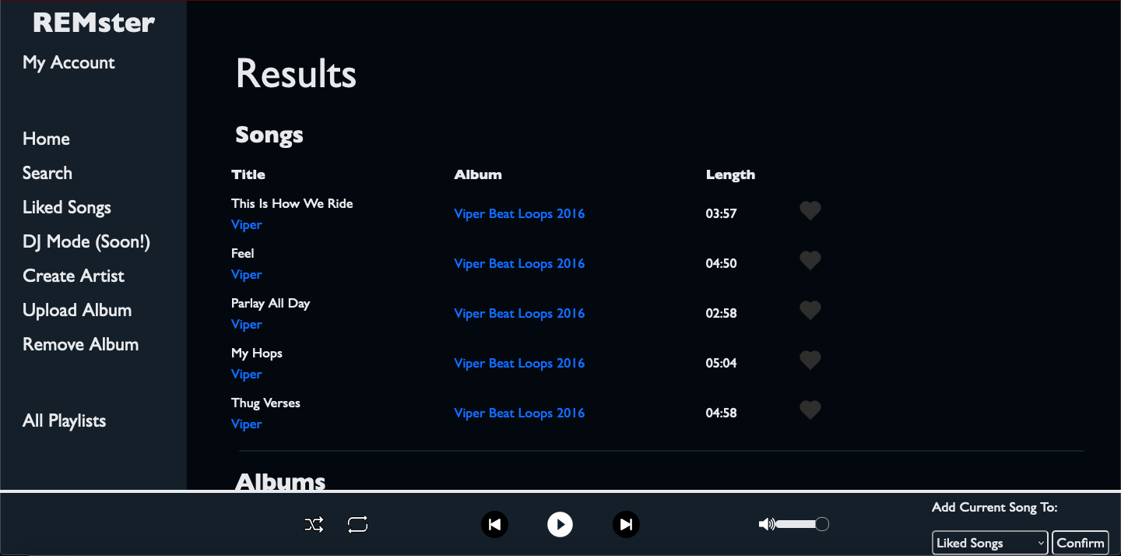
Results Page - Songs
Notes:
The search results are designed to deliver users exactly the content they ask for. This example searches for “Viper”, an artist. Note that the search also returns an assortment of songs by that artist for quick access.

Slide 12
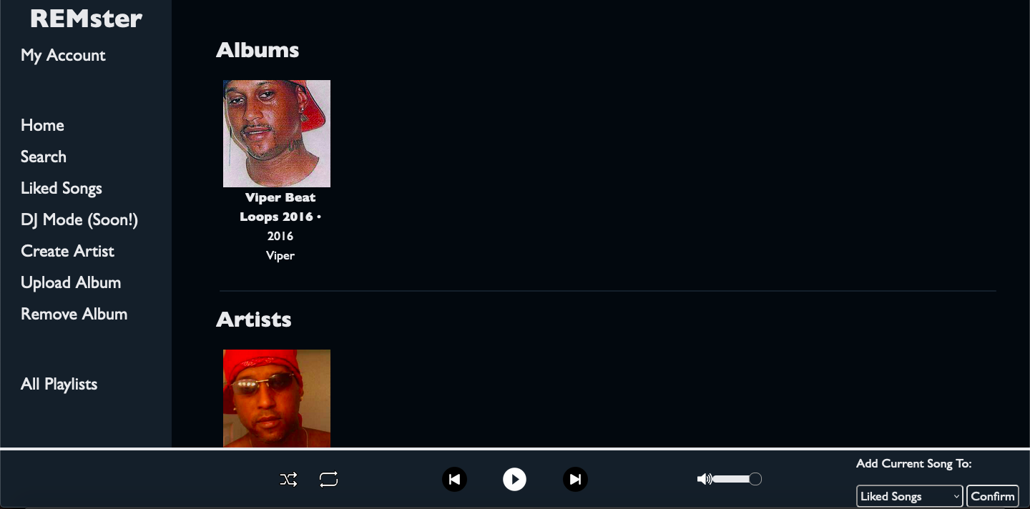
Results Page - Artists, Albums, Playlists
Notes:
Further down on the search page are Album, Artist, and Playlist results. Playlists will only appear in search results if the playlist was created by the current user or the playlist has been made Public. Any playlist can be made public, even Liked Songs, allowing other users to sample your tastes. In this way, REMster retains a lot of the social features of Spotify, even without functionality like adding friends (which is often more confusing than it is helpful).

Slide 13
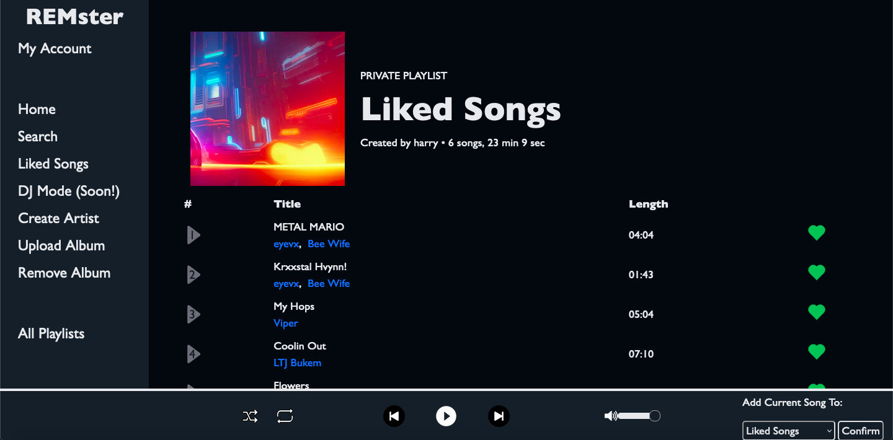
Liked Songs
Notes:
This is the Liked Songs page. All songs liked by a user are collected here. This page can also be accessed from the “All Playlists” menu. All the songs that are displayed have a heart icon on the right hand side, and if one presses the heart it toggles it between liked and not liked.

Slide 14
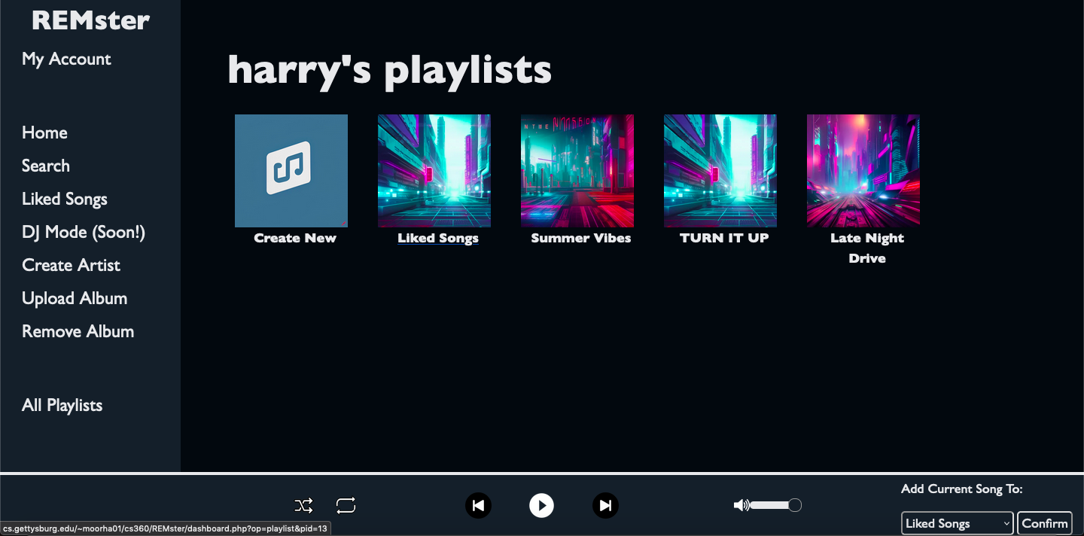
All Playlists
Notes:
By clicking the “All Playlists” menu option, a user can access all of their playlists, including their Liked Songs. A user also has the option to create a new playlist, which directs them to a screen where they set an initial name and decide whether the playlist is to be made Public.

Slide 15
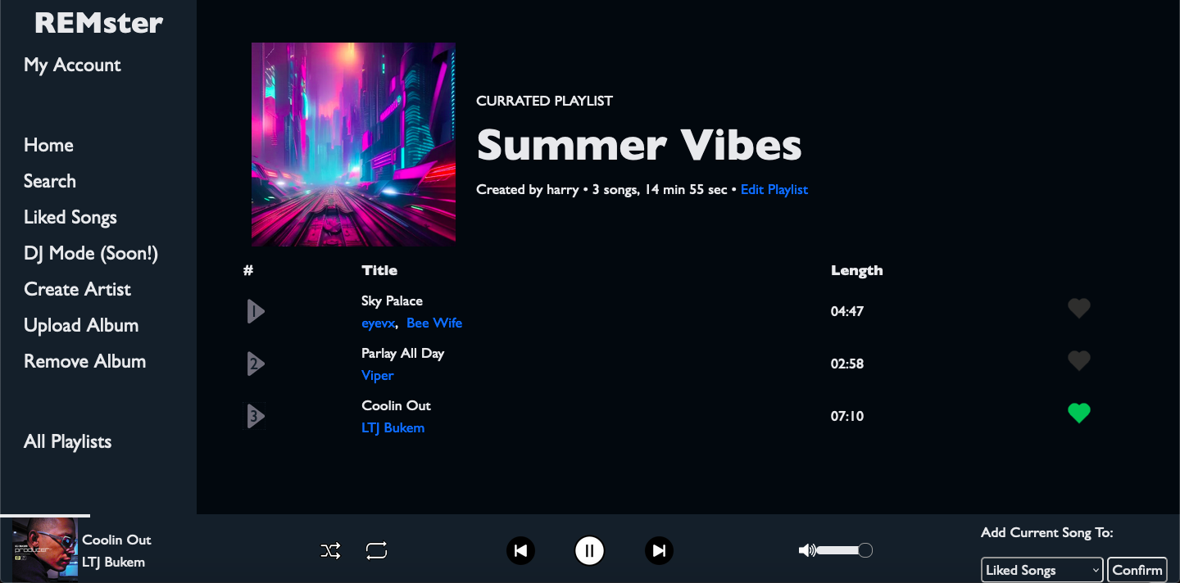
Individual Playlist
Notes:
This is the view for an individual playlist. Note that every instance of a song allows that song to be Liked or Unliked. The blue text indicates clickable objects. Every instance of a song comes with associated Artist links, which navigate a user to that Artist’s Profile page. Clicking on the play button/track numbers begins playback. At the bottom of a screen, you can see the user is currently listening to “Coolin Out”. The control buttons work exactly as expected, allowing navigation between the songs of a playlist.

Slide 16
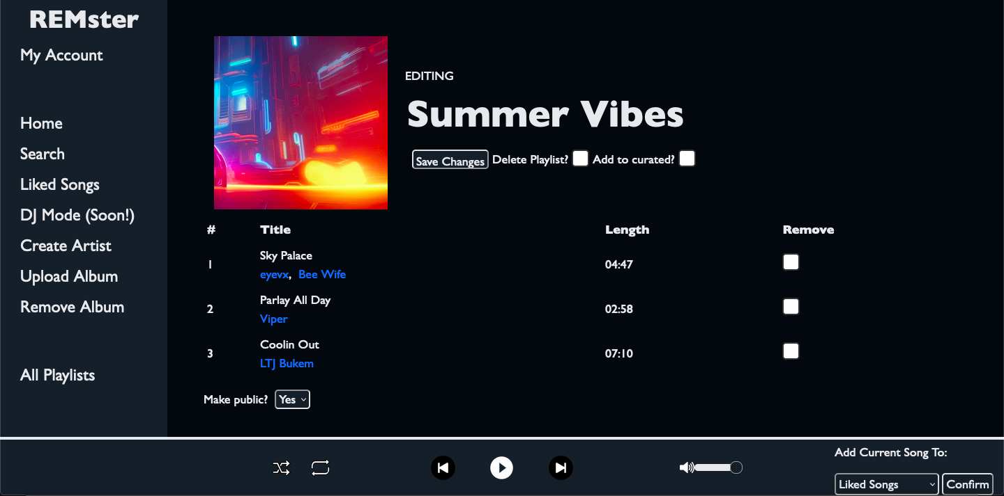
Editing playlist
Notes:
By clicking ‘edit playlist’, one can change the name, remove songs, delete the whole playlist, and make it public. Because the current user is an admin, they also have the option to add the song to the curated playlists list, which will recommend that playlist on all user’s home page. Note also that editing a playlist prevents a user from beginning playback. This avoids issues that would arise from deleting songs during playback.

Slide 17
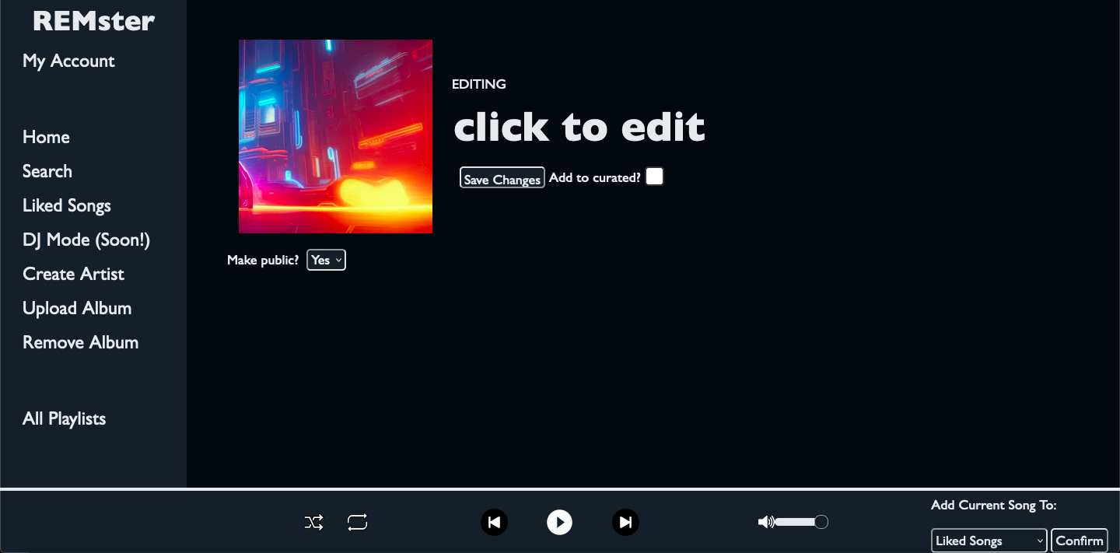
Creating New Playlist
Notes:
This is the view when you click “Create New”. It includes a default title directing the user to edit, but the title can be changed at any time. If a user does not click “Save Changes”, the operation is aborted, preventing the accidental creation of playlists. The art chosen for playlists is a random selection from a pool of AI-generated art. Note that there is no option to delete playlist - naturally, we wouldn’t want to allow the deletion of a playlist that doesn’t exist yet!

Slide 18
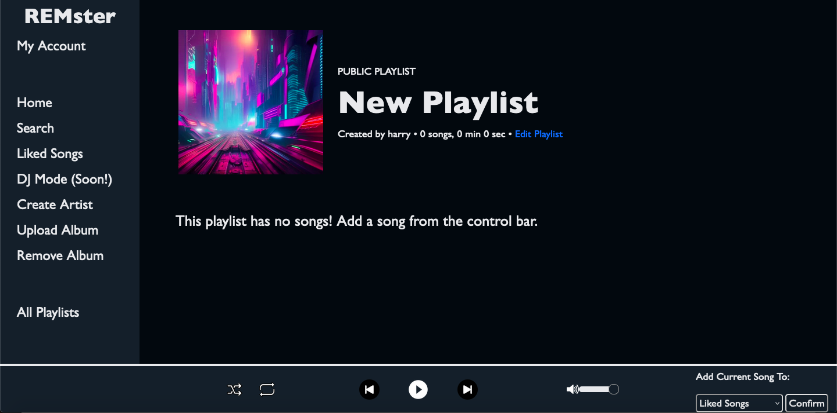
Empty Playlist
Notes:
This is the playlist page when a new playlist is created. The user sees a message prompting them to add songs to the playlist, the mechanism for which is discussed later.

Slide 19
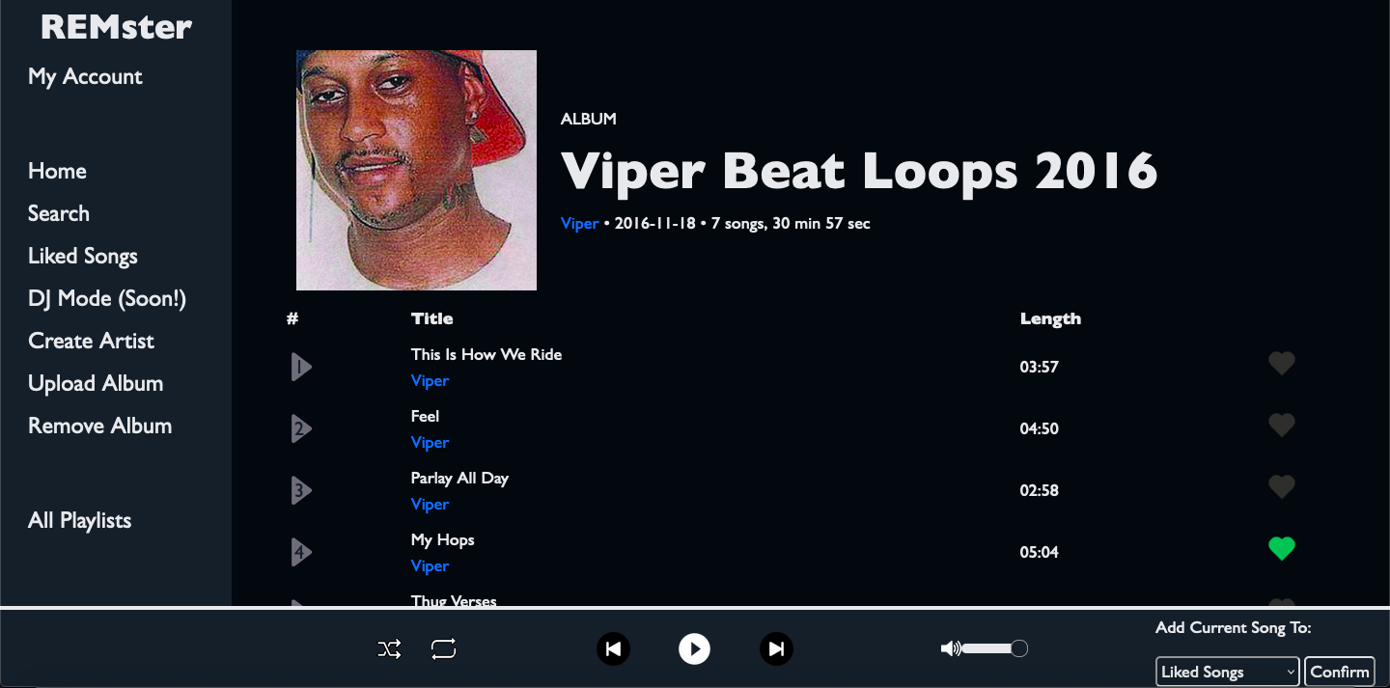
Album Page
Notes:
Albums can be viewed similarly to playlists, except that albums cannot be edited. They have all the same functionality of playback and navigation. Note the details at the top of the page - the header text indicates the current page being viewed is an album. The release date is also visible, as well as the number of songs and the duration of the album, calculates as the total runtime of all songs.

Slide 20
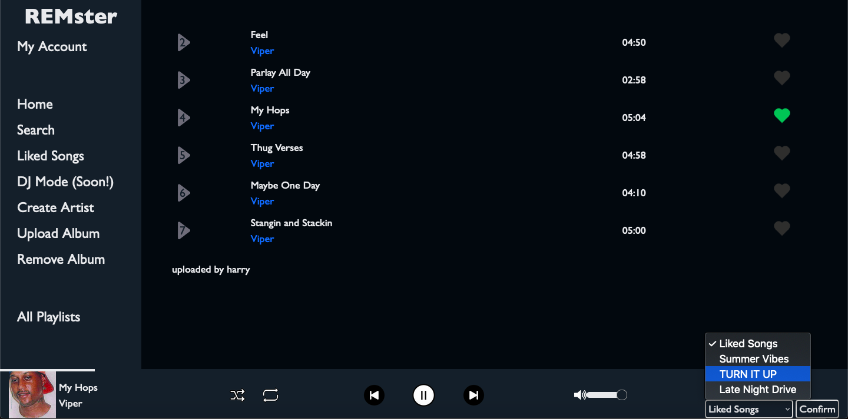
Album Page - Song Playing
Notes:
The song bar at the bottom contains all the songs necessary for playing a song, and contains other functionalities like shuffle, repeat, skipping, volume, and adding the song to a playlist. The album page also includes the username of the administrator who uploaded the album. Also visible in this screenshot is the mechanism for adding songs to a playlist. A dropdown is visible on the right side of the control bar, and whenever a song is playing, the user may select one of their playlists and add the current song to it. The user is disallowed from confirming if no song is playing.

Slide 21
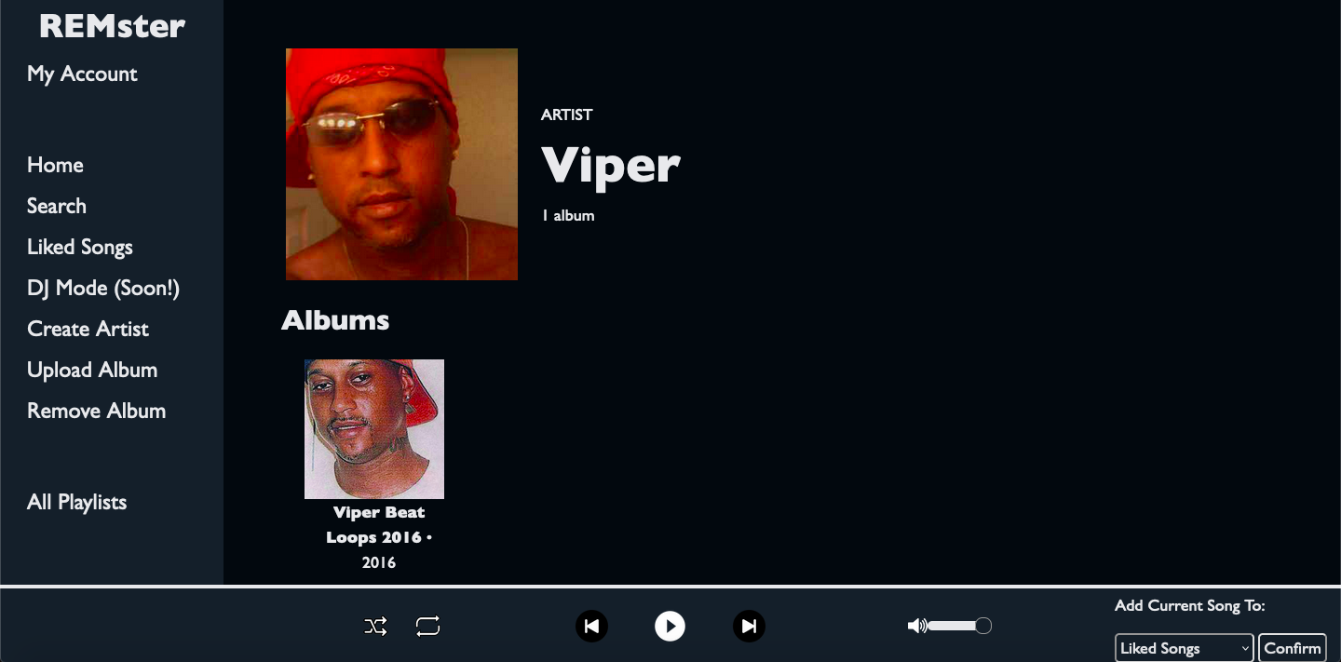
Artist Page
Notes:
If you click on an artist, you will be brought to their page, where you can see the albums and playlists in which that artist is featured. In this case, the artist “Viper” is displayed, and one can see the albums and playlists that Viper is in. Similarly to search results, playlist results will only appear if the playlist is public or if the current user is the owner of the playlist.

Slide 22
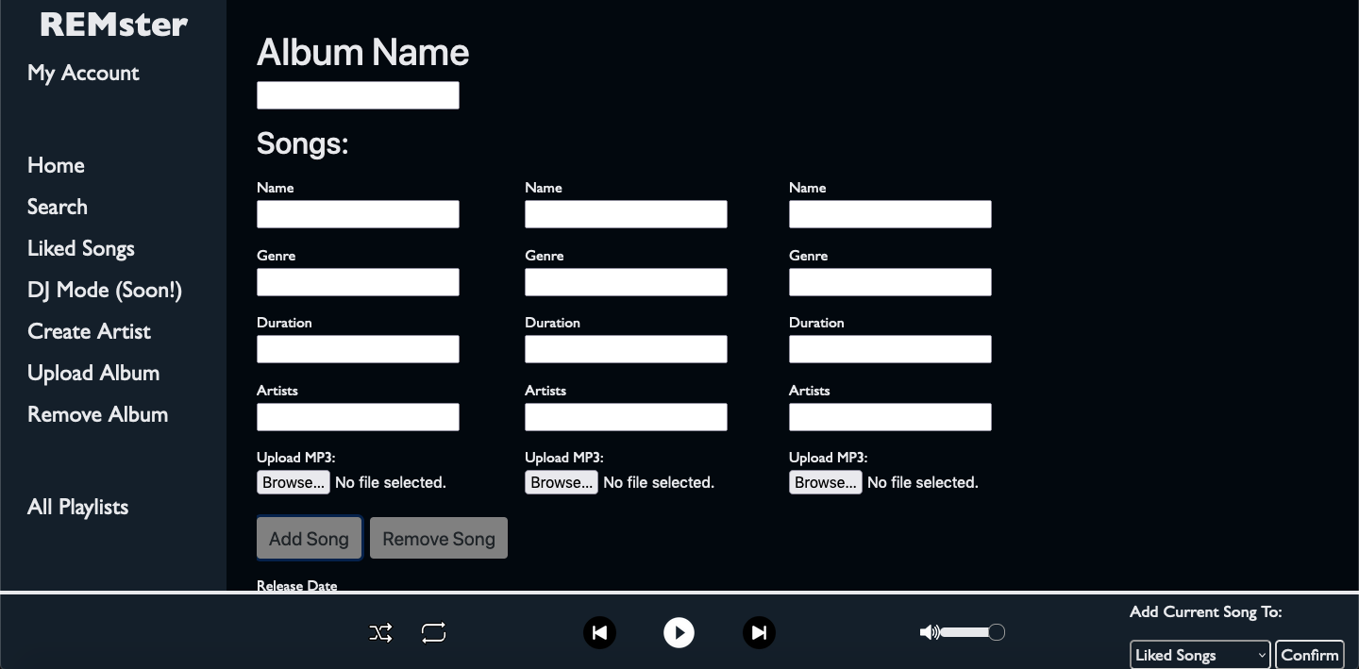
Admin - Upload Album
Notes:
Admins can upload albums with this form, accessed from the sidebar. They can add as many songs as they want to the album, and put the desired metadata. A song can have several artists or genres. By clicking the “Add song” button, one can add forms horizontally to add more songs: there would be another instance of the name, genre, duration, artists, and upload MP3 fields each time you press the button. There is also a “Remove Song” button in case the admin clicked the add song button too many times. Currently, due to the server limits, each uploaded file must be under 2MB, and the form must contain no more than 8MB. However, if the php.ini file was configured differently in the apache server, this form could handle much larger files that a normal audio streaming site would have.

Slide 23
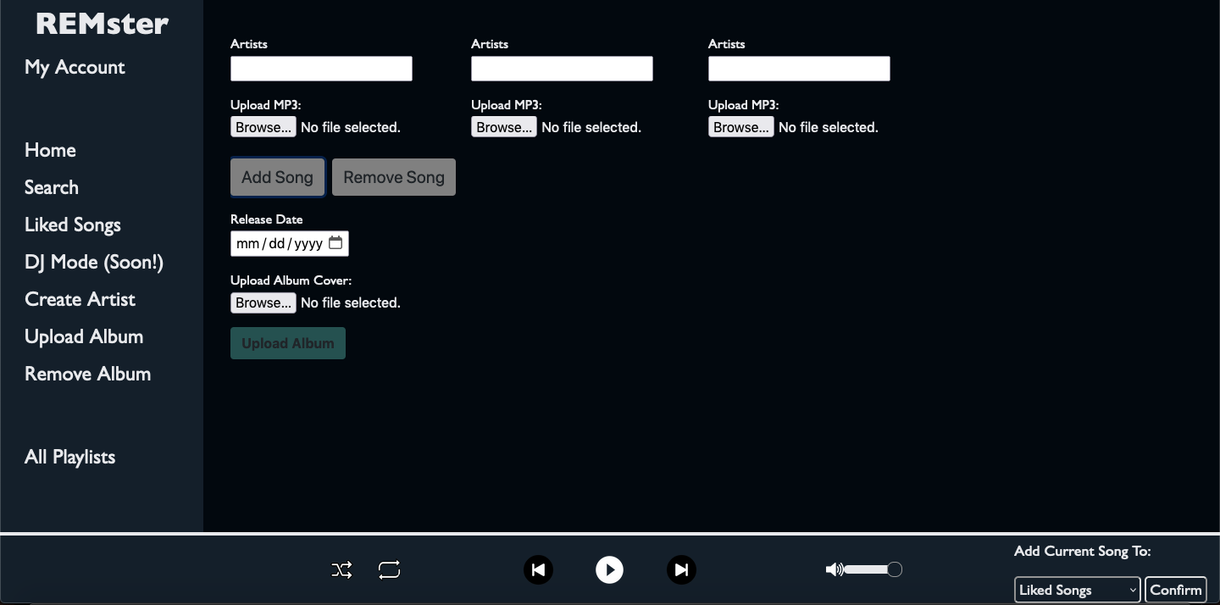
Admin - Upload Album Scrolled Down
Notes:
Admins can upload albums with this form, accessed from the sidebar. They can add as many songs as they want to the album, and put the desired metadata. A song can have several artists or genres. By clicking the “Add song” button, one can add forms horizontally to add more songs: there would be another instance of the name, genre, duration, artists, and upload MP3 fields each time you press the button. There is also a “Remove Song” button in case the admin clicked the add song button too many times. Currently, due to the server limits, each uploaded file must be under 2MB, and the form must contain no more than 8MB. However, if the php.ini file was configured differently in the apache server, this form could handle much larger files that a normal audio streaming site would have.

Slide 24
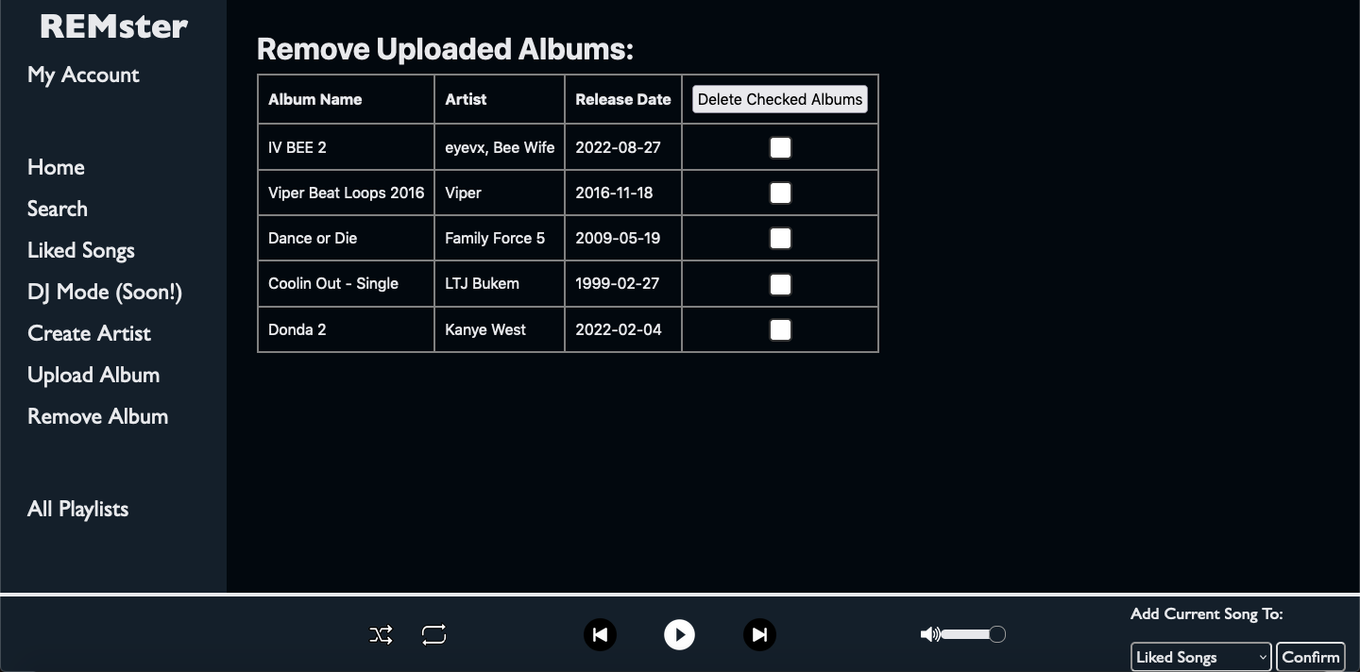
Admin - Delete Album
Notes:
In case an admin wants to delete any of their albums, they can do so on this page, which can be accessed from the sidebar. This allows the admin to take down any of their uploaded albums if for instance the artist/manager does not want that album on the streaming service anymore. They can delete multiple at once with the “delete checked albums” column in the table.

Slide 25
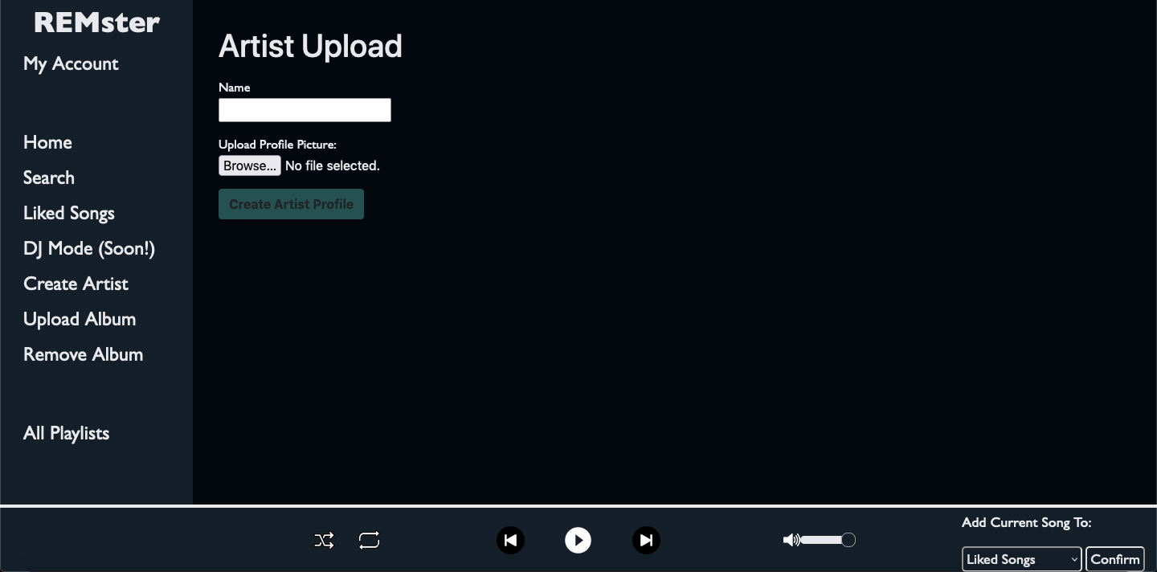
Admin - Upload Artist
Notes:
In order to upload an album with an artist, that artist first must have a profile. An admin can create an artist profile with this form accessed from the sidebar. All that one needs to upload an artist is a name and a profile picture. To upload an album, the admin must create profiles for each of the artists using this page, and then they can upload the album. If the admin had tried to upload an album attributed to an artist who hadn’t been created, they would be prompted to create the artist and redirected to this page.

Slide 26
Challenges
Song playback
Handled mostly in JavaScript using howler.js
Metadata had to be passed from HTML -> PHP -> JS to allow movement between songs
Upload Limitations
PHP has default limit of 2MB file upload, 8MB post upload
This limitation could be lifted, but would adjust server elements
CSS Styling
Getting elements to fit correctly while allowing reactivity was difficult
Notes:
Through our development, we encountered several challenges in the design process. In order to have song playback and some important interactive form functionalities, we used JS as well as PHP. In particular, we used the howler.js library to play the music. Additionally, we ran into limitations with file sizes for uploading things. The apache server has the max filesize that can be uploaded as 2MB, with 8MB as the limit for how much can be uploaded within a form. To circumvent this for demonstration purposes, we manually added some content to the backend to show what it would look like if this was running on a different server that allowed larger uploads. Lastly, there were numerous css headaches for making different parts of the site. Eventually, we found workarounds to most of our styling problems.

Slide 27
Future Work
Genre
Would be nice to search by genre, or add more emphasis when delivering a user recommendations
DJ Mode
Original idea: user picks genre, REMster generates list of songs in that genre
Songs would have <= 2 BPM difference, giving the illusion of a smooth DJ mix
Additional Playback QOL
Because playback handled in JS, page navigation interrupts playback
Originally intended to allow playback to continue while navigating the site
Could use async-JS-XML (AJAX), would require more time to implement smoothly
Could preload Howl objects to reduce load time between songs
Notes:
Some additional features that could be added are search by genre, DJ mode, and some additional changes to how playback functions. DJ mode is a feature we wanted to implement where REMster recommends songs to a user based on a genre. Additionally, there are steps we can take to reduce playback irregularities, such as page changes or load times.

Slide 28
Thank you for the opportunity!
REMster
The best of both worlds!
Notes:
Thanks for listening! We hope that REMster can be an enjoyable service for all music enjoyers.

